Slide 1
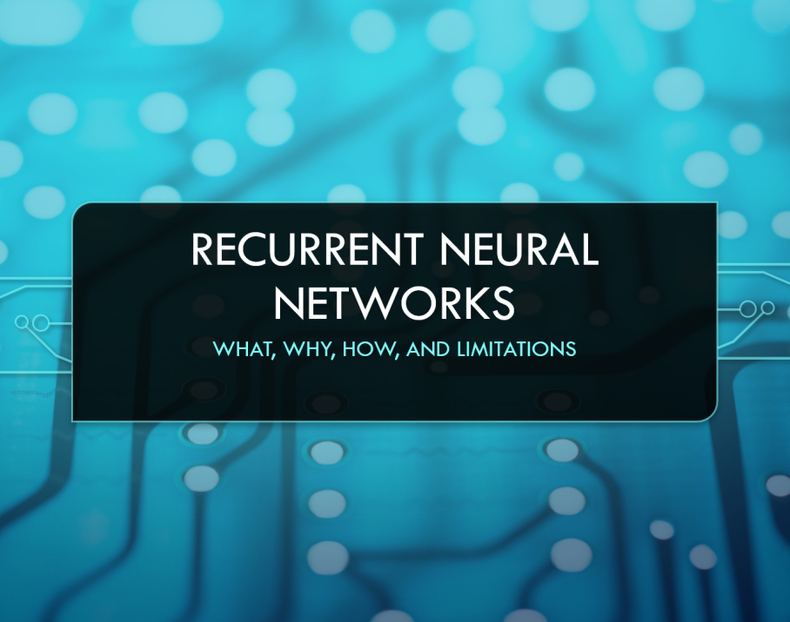

Topic: Recurrent Neural Networks (RNN & LSTM)
Present Date: 2023/11/08
Presenter: 何哲平 (Ho, Che-Ping)
Student ID: 111C71008
Class: 人工智慧科技學位學程碩士班

Slide 2

Outline
RNN (Recurrent Neural Networks)
Why do we need RNN?
What the function of RNN?
The limitation of RNN?
LSTM (Long Short-Term Memory )
Why do we need LSTM?
What the function of LSTM?
The limitation of LSTM?
GRU (Gated Recurrent Unit)
The structure of GRU
Comparison GUR with LSTM
Notes:
背景圖像: 有從主而來的智慧。

Slide 3
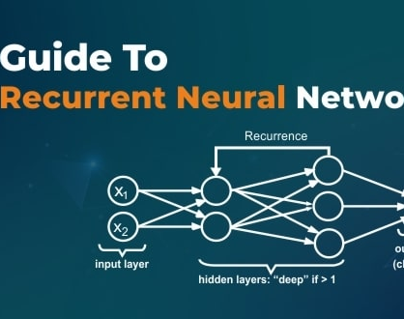

RNN (Recurrent Neural Networks)
Why do we need RNN?
What the function of RNN?
The limitation of RNN?

Slide 4
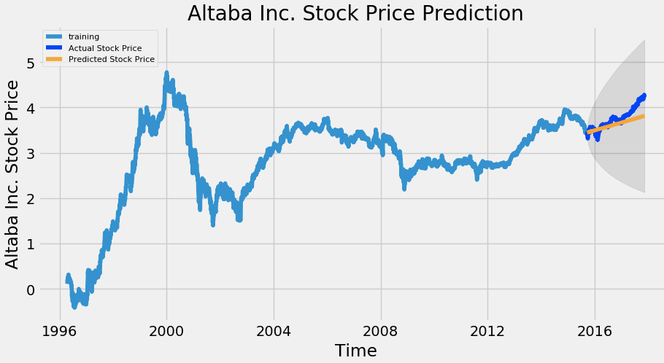
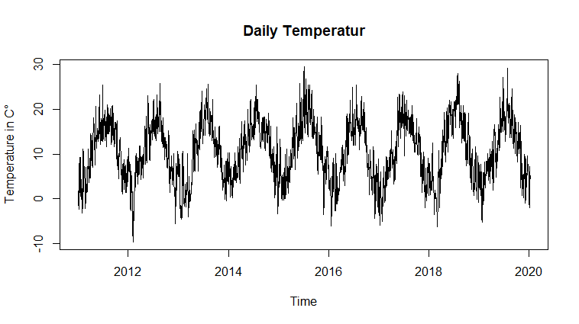
RNN (Recurrent Neural Networks)
Temperature Series Data
〔Think〕
Why do need RNN?
To solve or process time series data problem.
How is about other Neural Networks, such as MLP?
The Feed Forward Networks, such as CNN, does not consider the temporal states.
What is time series data?
A sequence of data points indexed in time order.
Example: Temperature, Speech, or Stock Price.
Stock Price Series Data
Notes:
In other words, feed forward networks does not consider the relationship between current sample and the previous samples.
For some kind of data, especially time series data, the relationship between current and previous symbols is very important.
EX. For stock-price data, we need to use the previous price to predict next price.
時間相關問題，就是當下的答案會受過去的答案影響，而且也會影響未來的答案的一種特殊情況。也可以說是次序相關問題。

Slide 5
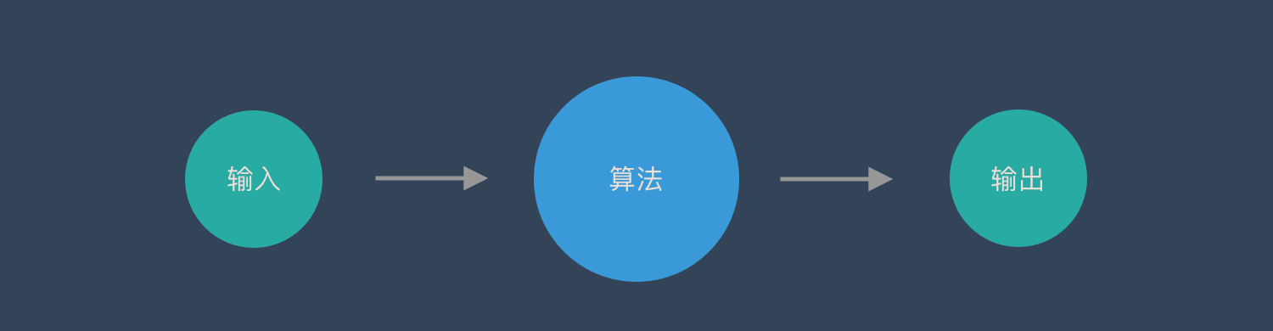

RNN (Recurrent Neural Networks)
Illustration of traditional neural network, such as feed forward network.
Feed Forward Network
Model
Input
Output
Prediction:
Dog
One input corresponds to one output.
Notes:
卷積神經網路– CNN和普通的演算法大部分都是輸入和輸出的一一對應，也就是一個輸入得到一個輸出。不同的輸入之間是沒有關聯的。

Slide 6
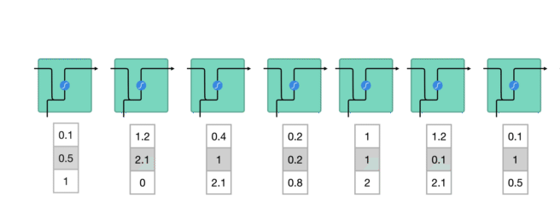
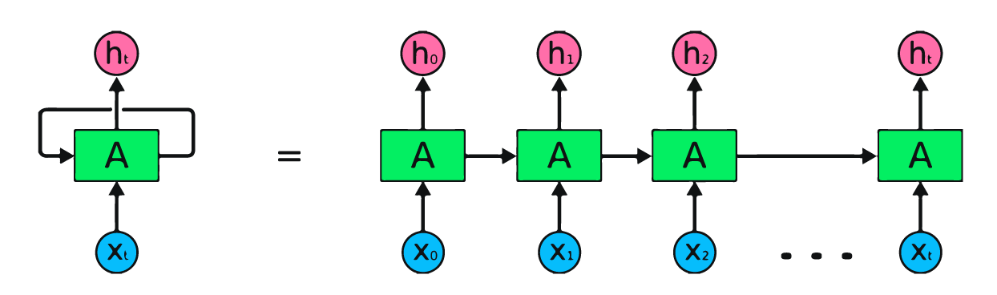
RNN (Recurrent Neural Networks)
Illustration of the Structure of RNN:
Use a loop, called Recurrent Connection resending the output back to itself, to memorize the previous information.
When the next output comes in, RNN will calculate the new output based on current input and the previous output.
Output
Recurrent
Connection
RNN
Input
Notes:
First words get transformed into machine-readable vectors.
Then the RNN processes the sequence of vectors one by one.
While processing, it passes the previous hidden state to the next step of the sequence.
The hidden state acts as the neural networks memory. It holds information on previous data the network has seen before.
The tanh activation is used to help regulate the values flowing through the network. The tanh function squishes values to always be between -1 and 1, thus regulating the output of the neural network.

Slide 7
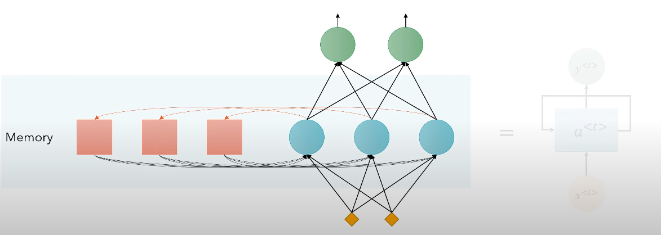
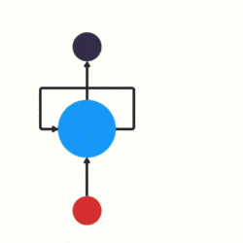
RNN (Recurrent Neural Networks)
To make it simple, RNN is an artificial neural network with memory.
Output
Hidden Layer
Memory:
Remember the previous output, so recurrent neural networks can memorize previous data in the previous state.
Input
Notes:
這個循環能夠讓資訊從神經網路中的上一步傳遞到下一步，雖然這些環看起來讓RNN變得有點複雜，但是它其實與傳統神經網路類似，只是把同一個網路多次複製，將資訊傳遞到下一個網路。

Slide 8
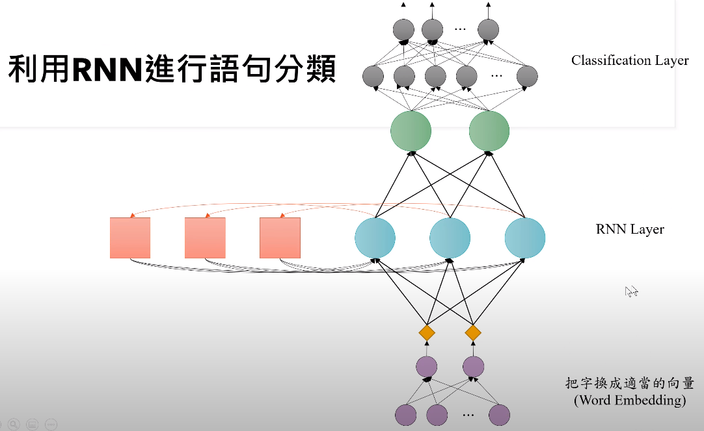
RNN (Recurrent Neural Networks)
Effective for speech recognition, language modeling, translation
〔Example：Classification
Many-to-One Problem〕
Classification Layer
Output
Positive or Negative review
RNN Layer
Code Tutorial:
https://youtu.be/ubDtr6dh0c8?si=_oF5MRoCfC1ReKf2
Word Embedding
Input
EX. "customer reviews"
Notes:
customer reviews: https://raw.githubusercontent.com/SophonPlus/ChineseNlpCorpus/master/datasets/waimai_10k/waimai_10k.csv

Slide 9
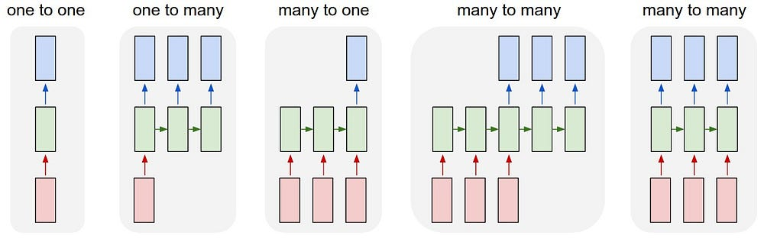
RNN (Recurrent Neural Networks)
The strength of RNN is allowing the input and output data not just a single set of vectors, but a sequence of multiple sets of vectors.
Type | Example
One-to-One | Classification
One-to-Many | Image Captioning
Many-to-One | Sentiment Analysis Text Classification
Many-to-Many | Translation Video Classification
Notes:
淺談遞歸神經網路 (RNN) 與長短期記憶模型 (LSTM) https://tengyuanchang.medium.com/%E6%B7%BA%E8%AB%87%E9%81%9E%E6%AD%B8%E7%A5%9E%E7%B6%93%E7%B6%B2%E8%B7%AF-rnn-%E8%88%87%E9%95%B7%E7%9F%AD%E6%9C%9F%E8%A8%98%E6%86%B6%E6%A8%A1%E5%9E%8B-lstm-300cbe5efcc3
LSTM RNN in Keras: Examples of One-to-Many, Many-to-One & Many-to-Many https://wandb.ai/ayush-thakur/dl-question-bank/reports/LSTM-RNN-in-Keras-Examples-of-One-to-Many-Many-to-One-Many-to-Many---VmlldzoyMDIzOTM
RNN 與 LSTM 的強大效果以及應用方向
遞歸神經網路強大的地方在於它允許輸入與輸出的資料不只是單一組向量，而是多組向量組成的序列。當只能一組固定大小的向量輸入，且只允許一組向量輸出時時，可以處理分類問題。但一組輸入多組輸出時，就可以處理將圖片自動標上文字的問題。多組輸入一組輸出則可以處理文本的情感理解，比如說從一段文章中知道是正面或反面的結果。而當可以處理多組輸入，多組輸出時，就可以處理自動翻譯，或是影片分類的問題。

Slide 10
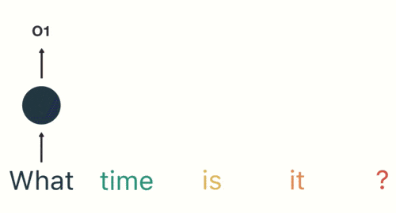
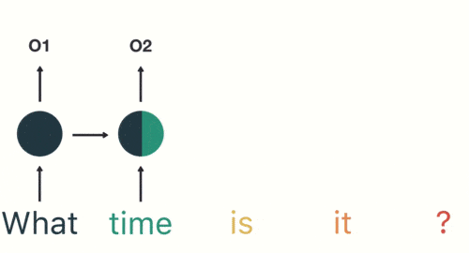
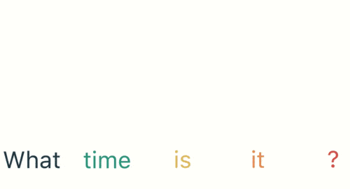

RNN (Recurrent Neural Networks)
However, RNN faces problem while encountering long series data.
For example: Asking for the time “ What time is it?”
We put the vocabulary as input in order.
Long-Term
Short-Term
The impact on short-term memory is greater,
but the impact on long-term memory is very small.

Slide 11

RNN (Recurrent Neural Networks)
Consider trying to predict the last word in the text like this,
I grew up in France and as a result, I speak fluent __________.
Of course, we know the answer is (D)French, because
we can integrate the entire text to fill in a certain sentence.
〔Options〕
A.) Chinese
B.) Mandarin
C.) Indonesian
D.) French
However, if the network (RNN) only knows a few nearby words, it may know that a language needs to be filled in here.
But which language should be filled in? It needs to find more information further back.
Unfortunately, as that gap grows, RNN become unable to learn to connect the information.

Slide 12
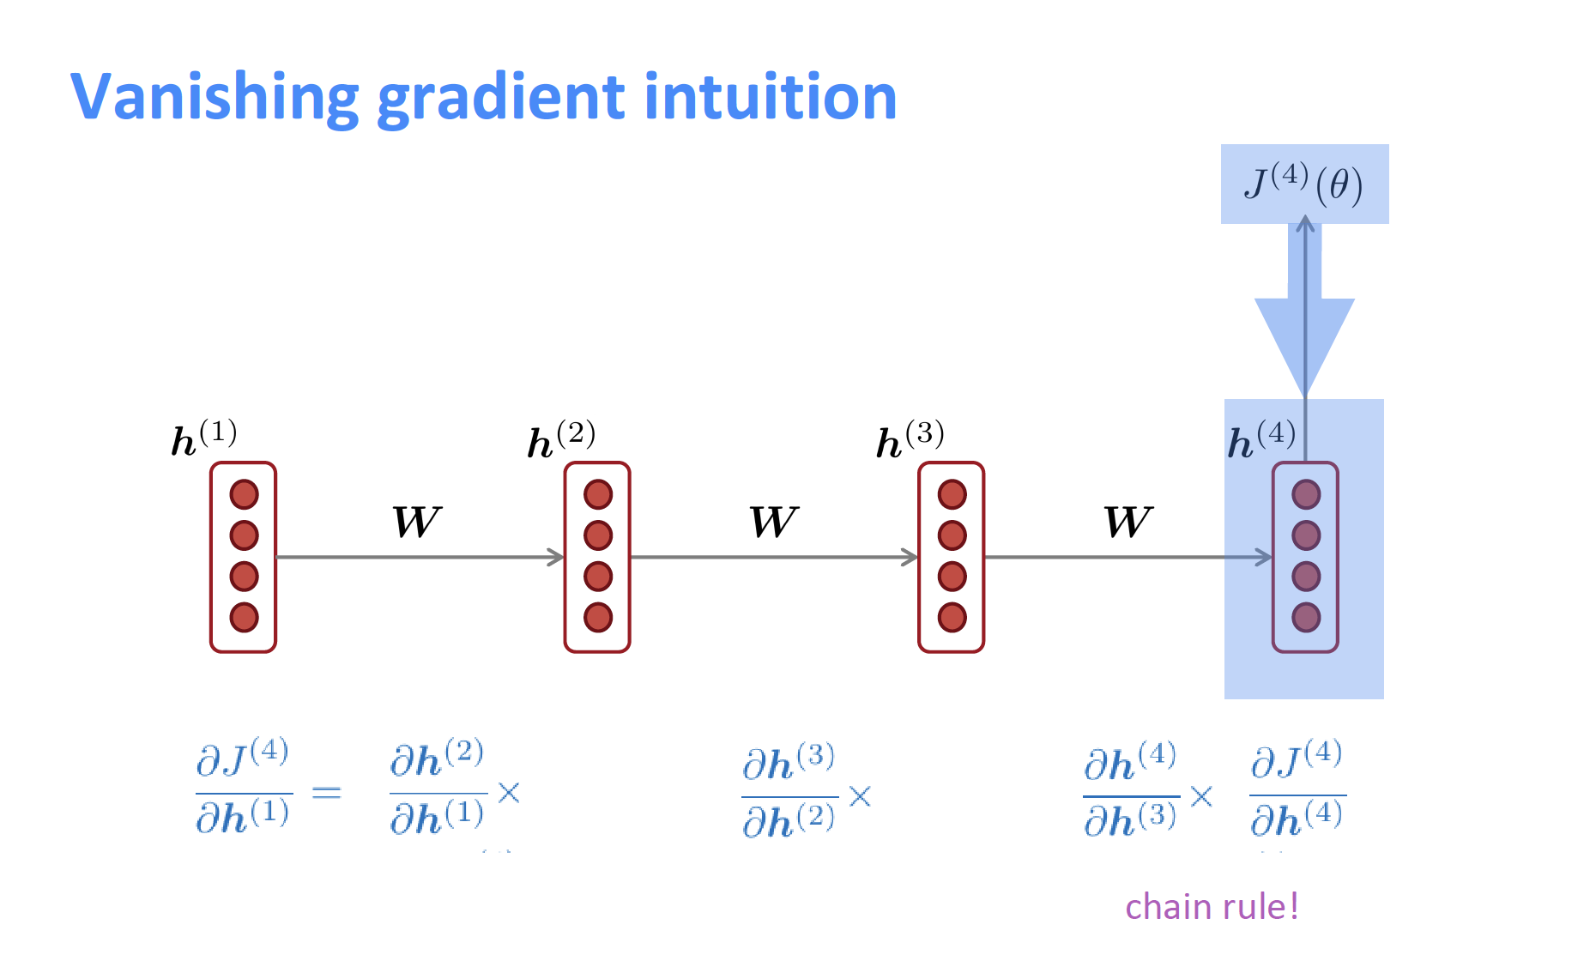
RNN (Recurrent Neural Networks)
Limitation of RNN
Suffer from short-term memory If a sequence is long, RNN will have a hard time carrying information from earlier time steps to later ones.
Moreover
Easy to learn, however, Hard to train. (Hidden states tend to exponentially explode or vanish.)
Vanishing / Exploding Gradient Problems
If we unroll RNN in the time domain, the weight matrix, the back propagation through time (BPTT), still needs to go back to multiple layers, like deep neural network.
Through multiple partial differentiation (偏微分) will cause the gradient to disappear, which makes it difficult for us to find the relationship between vocabularies in long sequences.
*What is Vanishing Gradient Problem?
Gradients are values used to update a neural networks weights.
The vanishing gradient problem is when the gradient shrinks as back propagation through time.
If a gradient value becomes extremely small, it doesn’t contribute too much learning, even stop learning.
Notes:
RNN 有短期記憶問題，無法處理很長的輸入序列
訓練RNN 需要投入極大的成本

Slide 13

RNN (Recurrent Neural Networks)
Application of RNN
NLP (Natural Language Processing)
Chatbot
Speech Recognition
Language Translation
Image Captioning

Slide 14
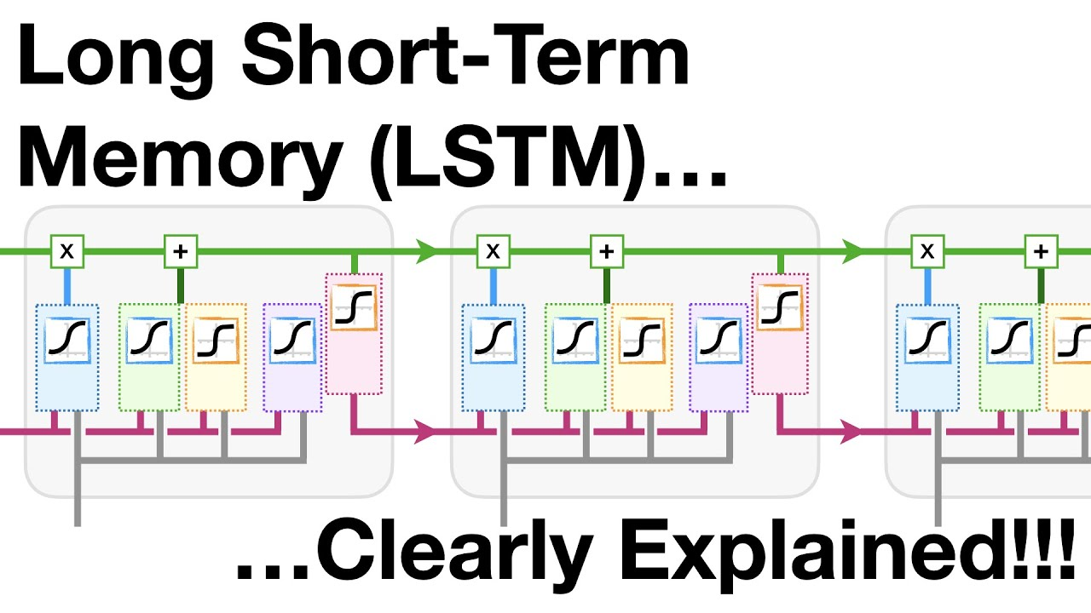
LSTM (Long Short-Term Memory )
Why do we need LSTM?
What the function of LSTM?
The limitation of LSTM?

Slide 15
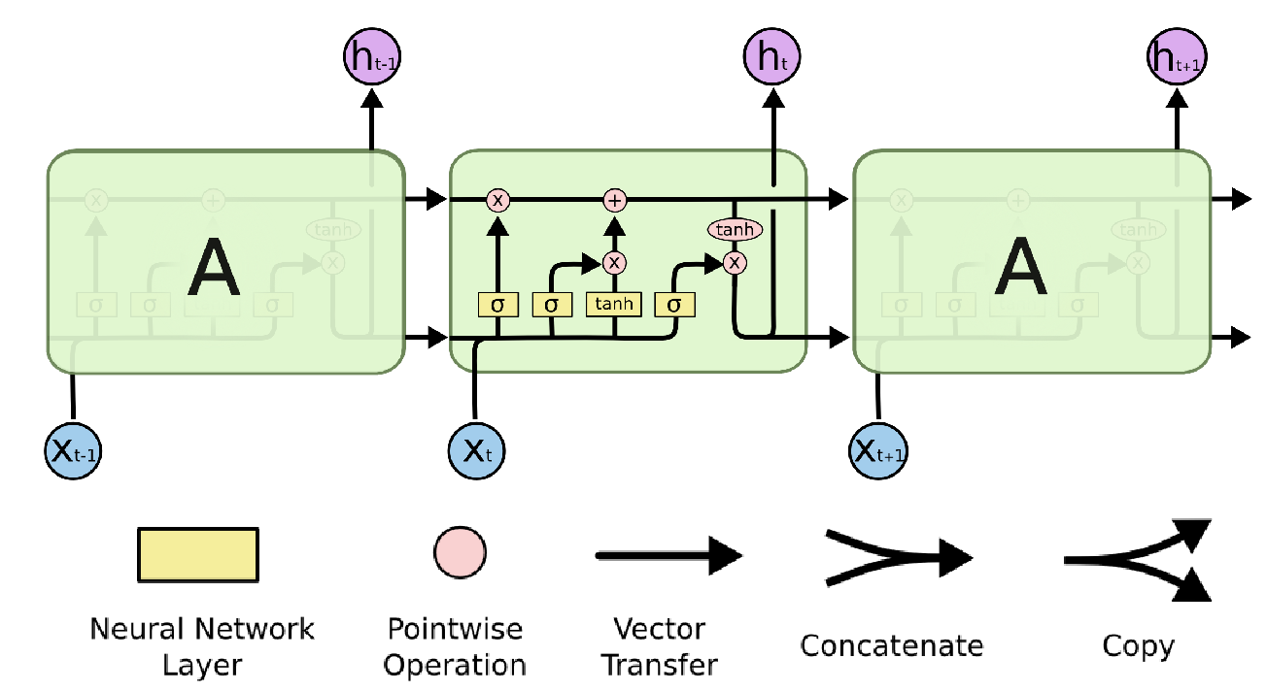
LSTM (Long Short-Term Memory)
LSTM :
Introduced by Hochreiter & Schmidhuber in 1997.
Explicitly designed to avoid long-term dependency problem.
Instead of having a single neural network layer, there are four, interacting in a very special way.
Furthermore, add multiple gates (input gate, forget gate, and output gate), regulating the flow of information.
(Result) Work tremendously well on a large variety of problems, and now widely used.

Slide 16
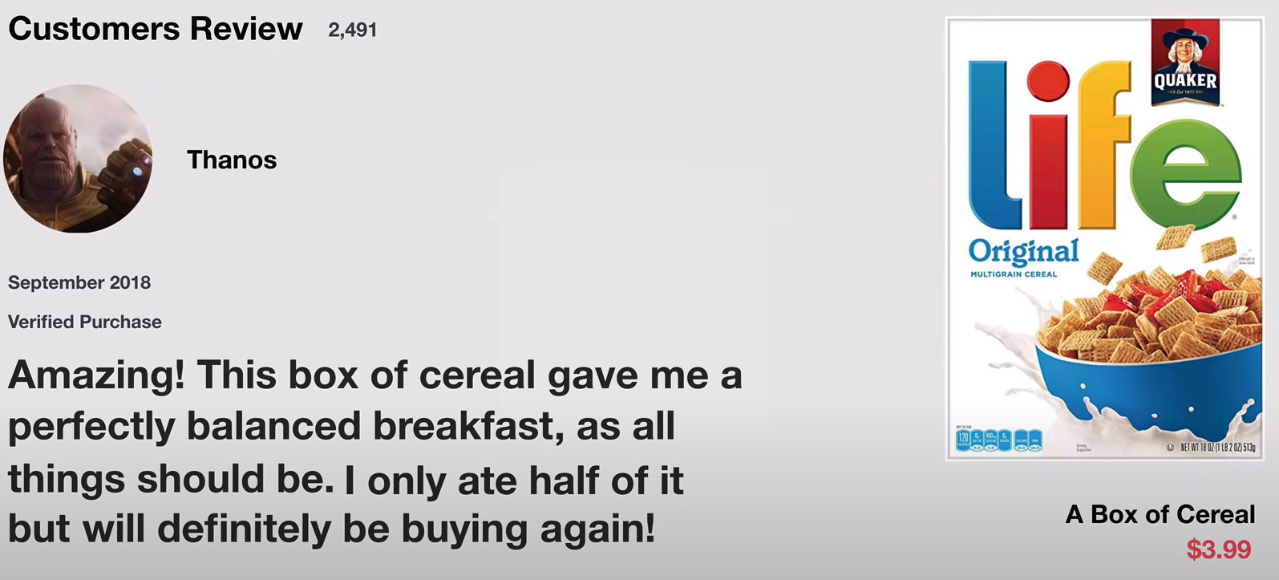
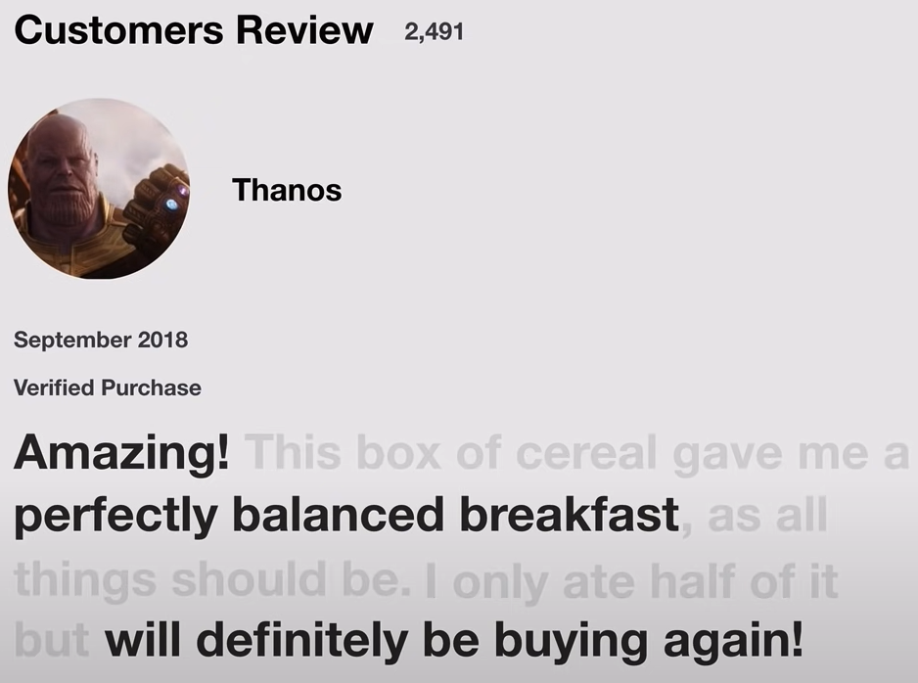
LSTM (Long Short-Term Memory)
Suppose you’re looking at reviews online. would you remember it word by word?
Certainly Not. your brain only remember important keywords subconsciously.
You pick up words like “amazing” and “will definitely buy again”.
You don't care much for words like “this”, “gave”, “all”, “should”, etc..
That’s essentially what LSTM does: keep only relevant information to make predictions.
Notes:
Let’s say you’re looking at reviews online to determine if you want to buy Life cereal (don’t ask me why). You’ll first read the review then determine if someone thought it was good or if it was bad.
When you read the review, your brain subconsciously only remembers important keywords. You pick up words like “amazing” and “perfectly balanced breakfast”. You don’t care much for words like “this”, “gave“, “all”, “should”, etc. If a friend asks you the next day what the review said, you probably wouldn’t remember it word for word. You might remember the main points though like “will definitely be buying again”. If you’re a lot like me, the other words will fade away from memory.
And that is essentially what an LSTM or GRU does. It can learn to keep only relevant information to make predictions, and forget non relevant data. In this case, the words you remembered made you judge that it was good.

Slide 17
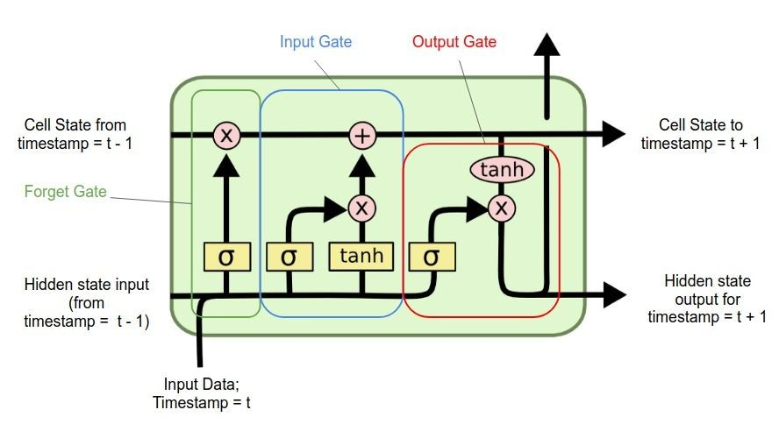
LSTM (Long Short-Term Memory)
Three important gates in LSTM Model:
Function:
keep only relevant info to make predictions, and forget non-relevant data, solving the problem of RNN short-term memory.
Input Gate: Control when to let new input in or ignore, how much input information to pass into the cell state.
Output Gate: Let the information impact the output at the current time step or not. Control how much information to pass to the next stage.
Forget Gate: Delete the trivial information, simulating the ability of human that we usually forget some trivial things.
Other Part of the network
Output Gate
Memory Cell
Forget Gate
Input Gate
Other Part of the network
Notes:
輸入門： 決定這一次的輸入需不需要被記憶，或者要記多少(可能只有記個三成)
遺忘門： 決定要不要遺忘之前的hidden state，也可以按比例遺忘。
輸出門： 決定這一次所得到的輸出要放多少(也是比例)進去hidden state小房間。
這三個門的合作可以讓某些不重要單字被忽略，進而讓梯度可以順利進行遠距離的傳遞，進而完成訓練。

Slide 18

LSTM (Long Short-Term Memory)
Step-by-Step Explanation of LSTM Structure
Cell State:
The Core Idea Behind LSTMs.
Horizontal line running through the top of the diagram.
Like conveyor belt, runs straight down the entire chain, with only some minor linear interactions.
Save the state information, easy and allow information to just flow along it without any change.
Notes:
Core Concept
The core concept of LSTM’s are the cell state, and it’s various gates. The cell state act as a transport highway that transfers relative information all the way down the sequence chain. You can think of it as the “memory” of the network. The cell state, in theory, can carry relevant information throughout the processing of the sequence. So even information from the earlier time steps can make it’s way to later time steps, reducing the effects of short-term memory. As the cell state goes on its journey, information get’s added or removed to the cell state via gates. The gates are different neural networks that decide which information is allowed on the cell state. The gates can learn what information is relevant to keep or forget during training.

Slide 19
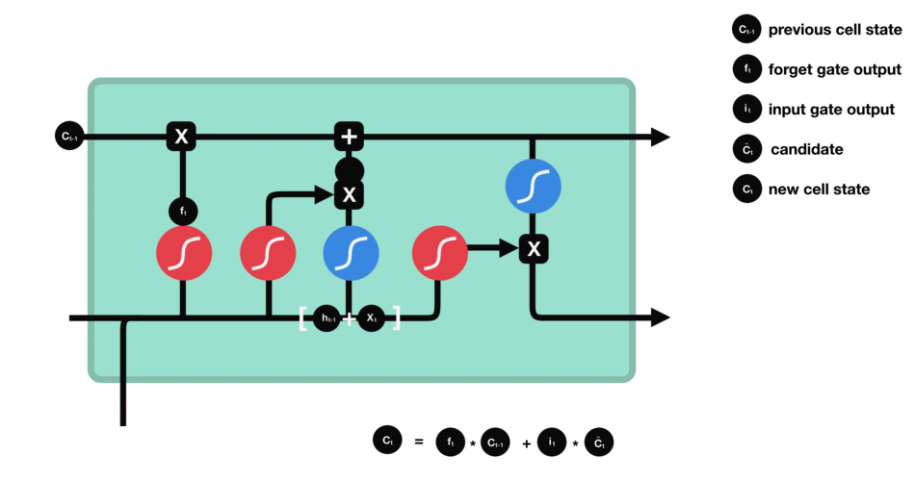
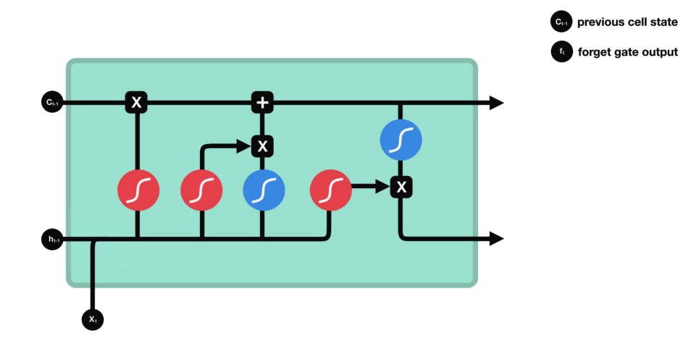
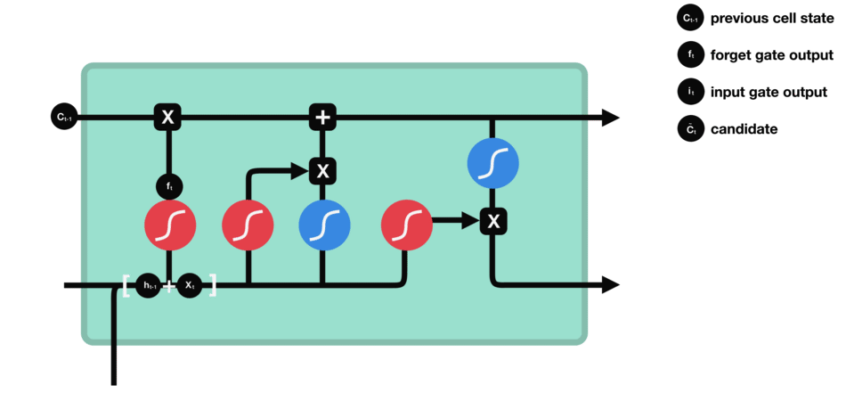

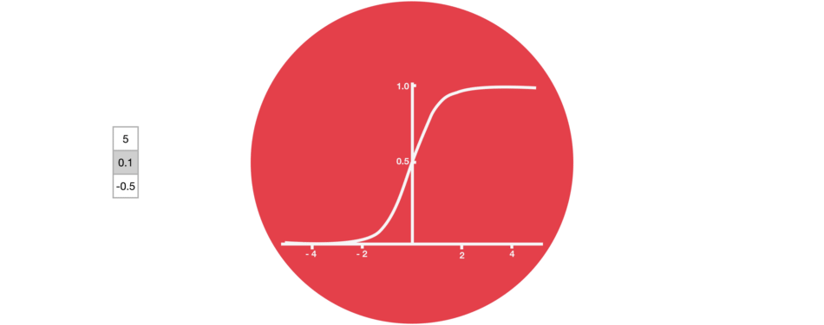
LSTM (Long Short-Term Memory)
Sigmoid
Step-by-Step Explanation of LSTM Structure
1st Step: Decide what information to throw away.
This layer called “Forget Gate” made by sigmoid layer, which outputs numbers between zero and one.
One represents “completely keep this”, while zero represents “completely get rid of this.”
2nd Step: Decide what new information to store.
This layer called “Input Gate”, deciding which values to update.
3rd Step: Update the old cell state into the new cell state.
4th Step: Decide what to output.
New Cell State and New Hidden carried over to the next time step.
Notes:
Sigmoid Activation squishes values between 0 & 1.
That is helpful to update or forget data because
Any number getting multiplied by 0 is 0, causing values to disappear or be forgotten.
Any number multiplied by 1 is the same value. Therefore, that value stays the same or is kept.
The network can learn what data should be forgotten or what data is important to keep.

Slide 20
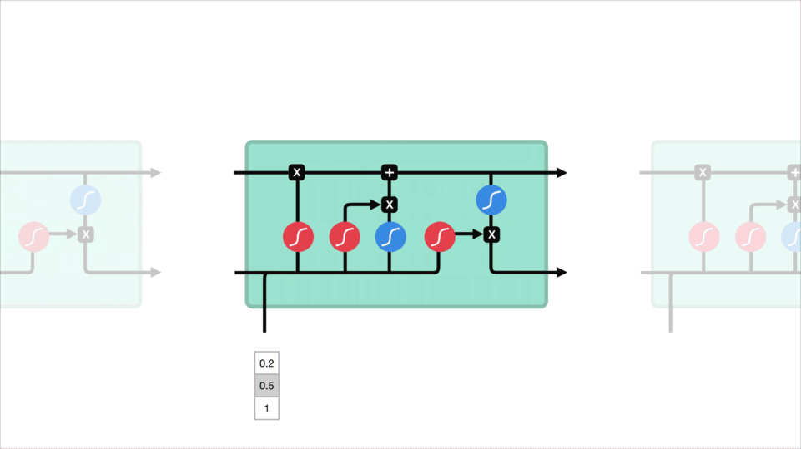
LSTM (Long Short-Term Memory)
Limitation of LSTM
As the number of parameters increases, making training much more difficult, and the execution becomes slower and slower.
Therefore, we sometimes use GRU, which is equivalent to LSTM but has fewer parameters, to build a large training model.

Slide 21
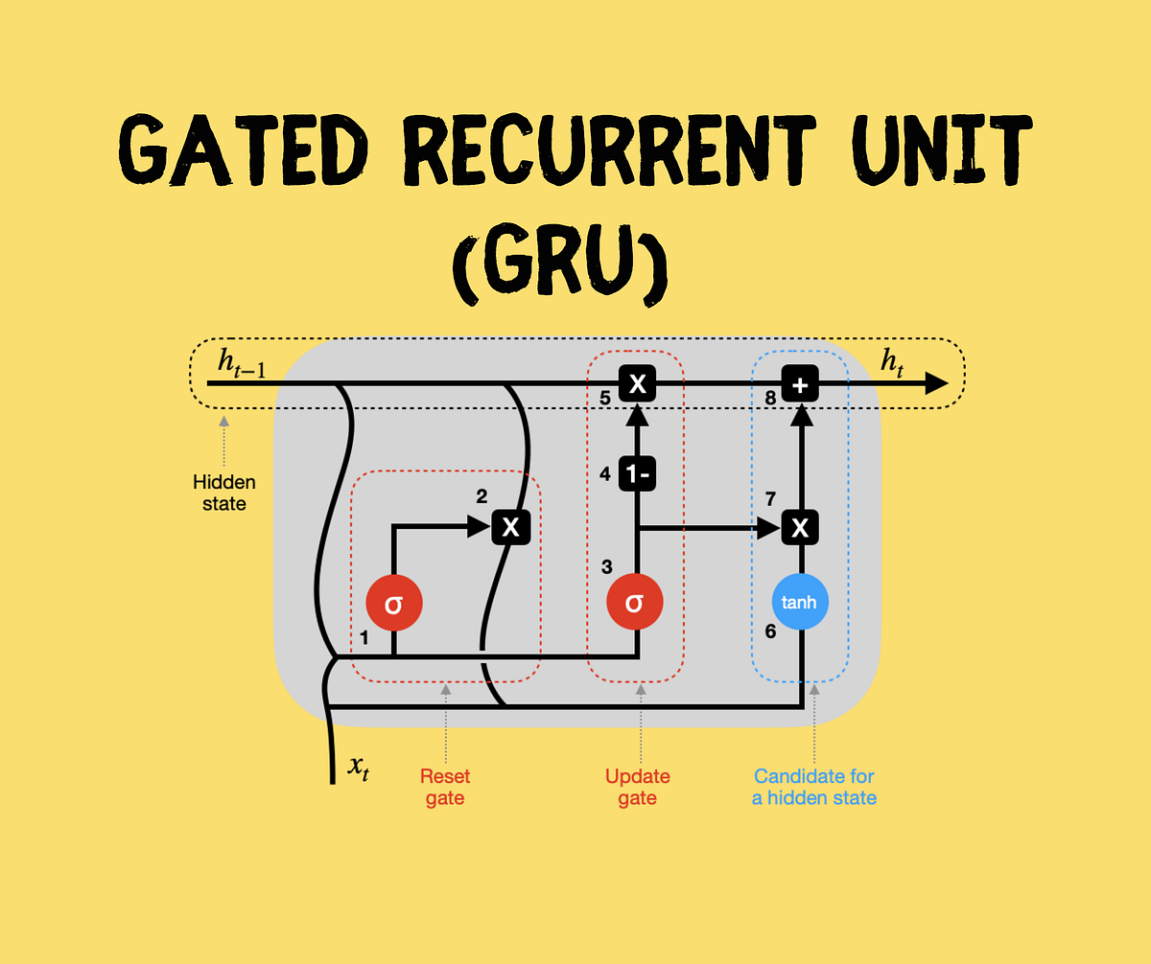
GRU (Gated Recurrent Unit)
The structure of GRU
Comparison GUR with LSTM
Notes:
GRU是LSTM的變體。他保留了LSTM劃重點，遺忘不重要訊息的特點，在long-term傳播的時候也不會被遺失。
GRU 主要是在LSTM 的模型上做了一些簡化和調整，在訓練資料集比較大的情況下可以節省很多時間。

Slide 22

GRU (Gated Recurrent Unit)
GRU:
Introduced by Kyunghyun Cho in 2014.
A slightly more dramatic variation on the LSTM
Combine the forget and input gates into a single “Update Gate.”
Also, merge the cell state and hidden state and makes some other changes.
Simpler than LSTM and has been growing increasingly popular.

Slide 23
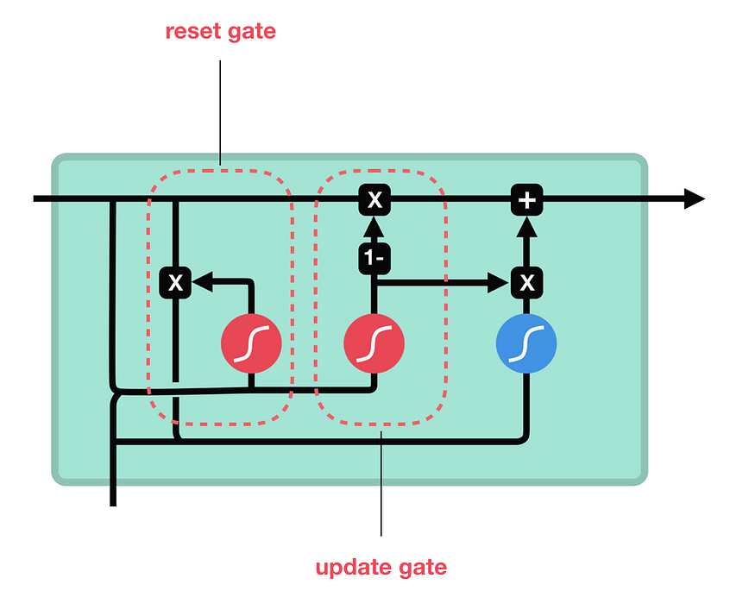
GRU (Gated Recurrent Unit)
Two important gates in GRU Model:
Update Gate:
Act similar to the Forget Gate and Input Gate of LSTM.
Decide what information to throw away and what new information to add.
Control what parts of hidden state are updated or preserved.
Reset Gate:
Control what parts of previous hidden state are used to compute new content.
Notes:
重製門： 決定是否要遺忘之前留下來的hidden state。
更新門： 決定這一次的hidden state所要留下來的比例。

Slide 24
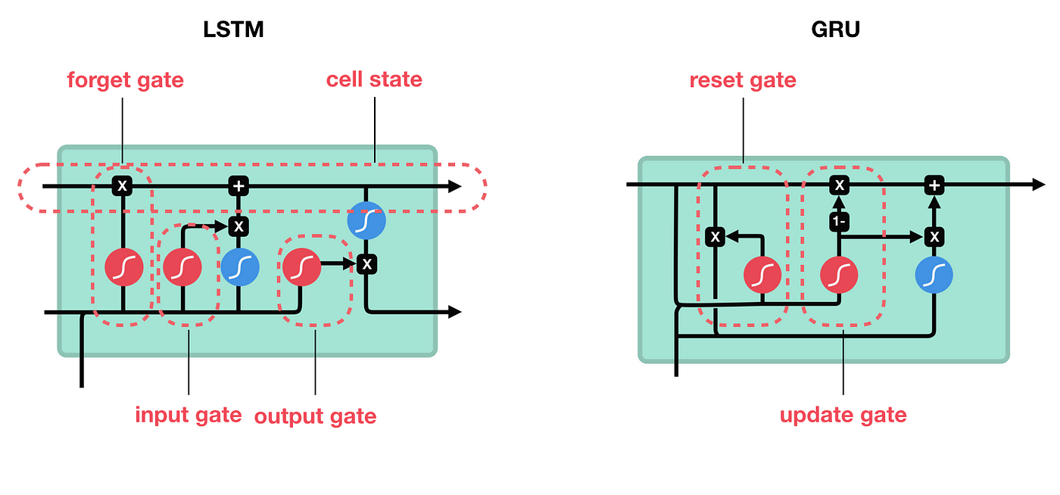
GRU (Gated Recurrent Unit)
Model Comparison between GRU & LSTM.
Combine the Forget Gate and Input Gate into a single “Update Gate.”

Slide 25
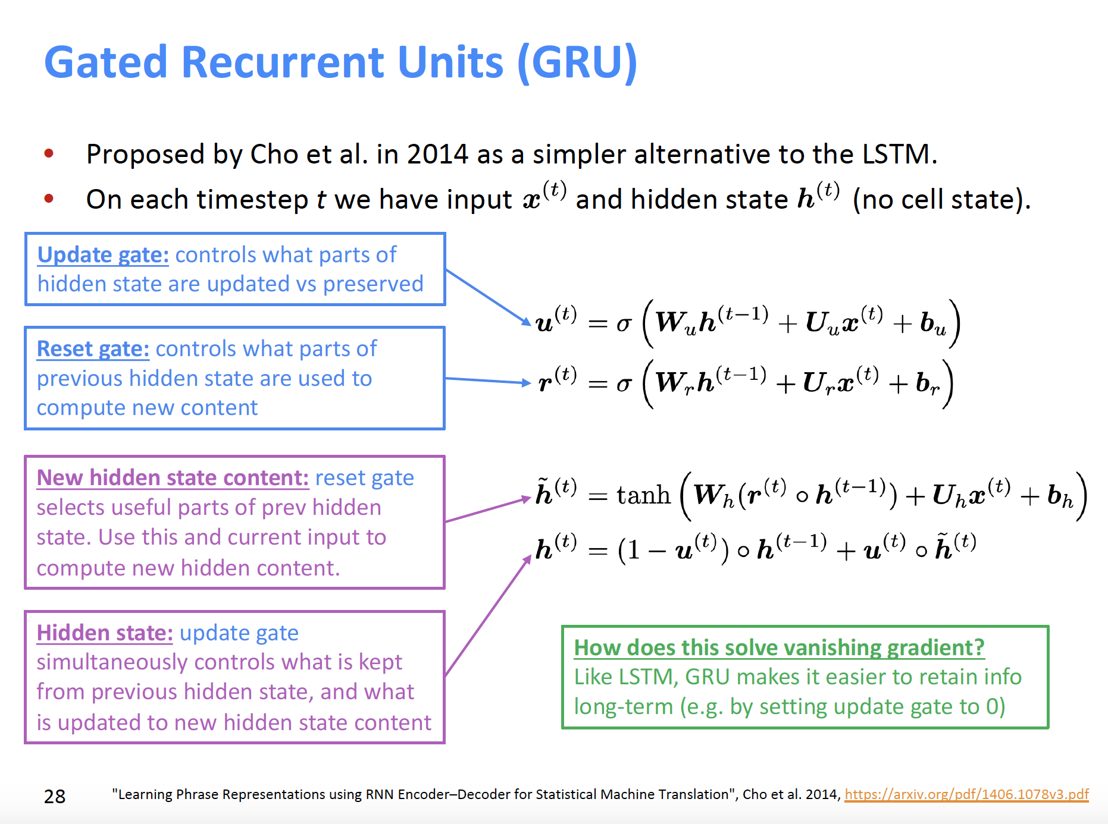
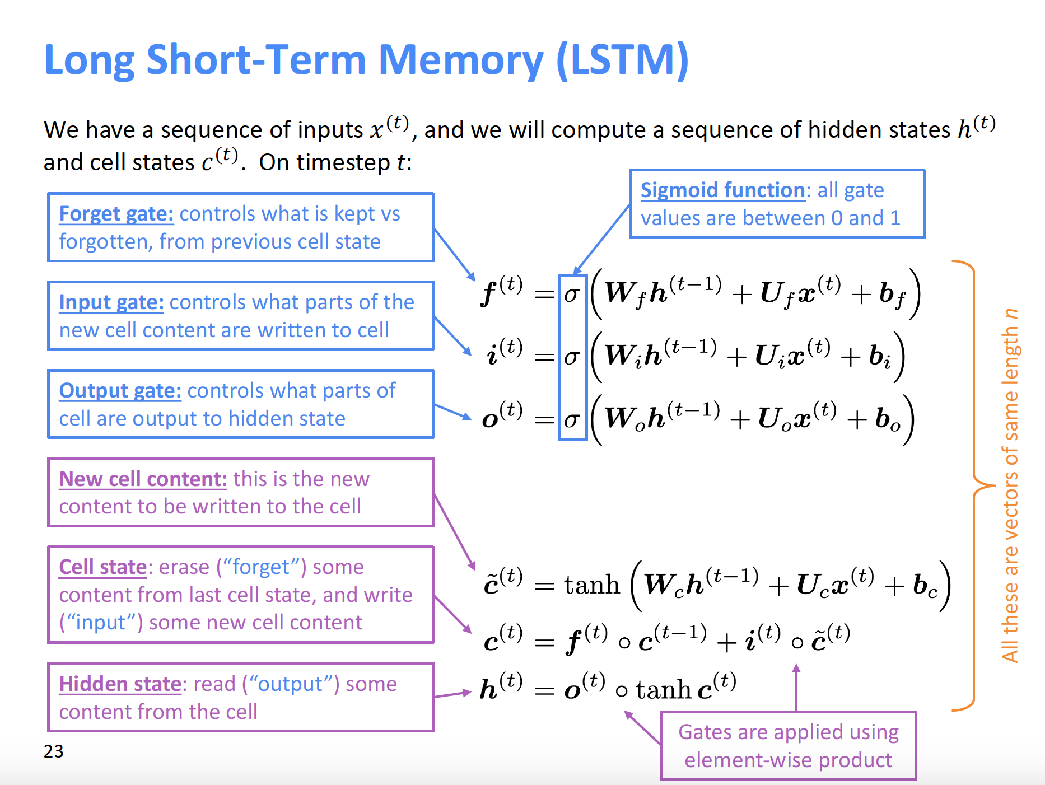
GRU (Gated Recurrent Unit)
Structure Comparison between GRU & LSTM: GRU has fewer tensor operations; therefore, a little speedier to train than LSTM.

Slide 26
GRU (Gated Recurrent Unit)
Reference:
https://www.youtube.com/watch?v=oBdcTW5TnsM
Performance Comparison between GRU & LSTM.
Comparison | LSTM | GRU
Operation Time | More / Slower | Less / Speedier
Quantity of Parameters | More | Fewer
Prediction Accuracy | Equivalent and Not Clear which one better.
Resources | More | Less
Note | Three Gates to decide whether to keep the memory or not. | Similar to LSTM (Also, A variant of RNN.) Speed up execution & Reduce memory usage.
Notes:
GRU’s has fewer tensor operations; therefore, they are a little speedier to train then LSTM’s.
There isn’t a clear winner which one is better.
Researchers and engineers usually try both to determine which one works better for their use case.

Slide 27
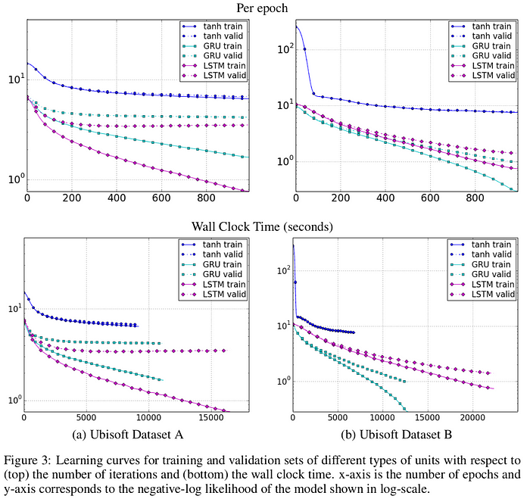
GRU (Gated Recurrent Unit)
Performance Comparison between GRU, LSTM and RNN.
Results of the models in speech signal recognition.
Both GRU and LSTM perform much better than the traditional RNN.
Although LSTM and GRU have their own advantages and disadvantages, the performance between LSTM and GRU is not significant.
The choice between LSTM and GRU should depend on the specific requirements of the task at hand.
Almost all state-of-the-art results based on recurrent neural networks are achieved with these two networks (LSTM or GRU).
Reference:
Comparing long short-term memory models (LSTM) with modified recurrent neural network models: GRU
Notes:
Reference:
https://tengyuanchang.medium.com/%E6%AF%94%E8%BC%83%E9%95%B7%E7%9F%AD%E6%9C%9F%E8%A8%98%E6%86%B6%E6%A8%A1%E5%9E%8B-lstm-%E8%88%87%E6%94%B9%E8%89%AF%E5%BE%8C%E7%9A%84%E9%81%9E%E6%AD%B8%E7%A5%9E%E7%B6%93%E7%B6%B2%E8%B7%AF%E6%A8%A1%E5%9E%8B-gru-813dec22ec6d

Slide 28

The End, Thank you.
Philippians 4:6-7:
Do not be anxious about anything, but in every situation, by prayer and petition, with thanksgiving, present your requests to God.
And the peace of God, which transcends all understanding, will guard your hearts and your minds in Christ Jesus.
Notes:
簡報完畢

Slide 29

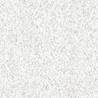
Reference
RNN
LSTM
GRU

Slide 30

Reference
〔RNN〕
recurrent neural network RNN in python https://www.youtube.com/watch?v=Dj7Bkhf3ccw
什麼是循環神經網路 Recurrent Neural Networks, RNN？ https://blog.tibame.com/?p=19075
循环神经网络 – Recurrent Neural Network | RNN https://easyai.tech/ai-definition/rnn//
RNN(遞迴神經網路)全面認識 https://medium.com/%E6%A9%9F%E5%99%A8%E5%AD%B8%E7%BF%92%E7%9F%A5%E8%AD%98%E6%AD%B7%E7%A8%8B/rnn-%E9%81%9E%E8%BF%B4%E7%A5%9E%E7%B6%93%E7%B6%B2%E8%B7%AF-%E5%85%A8%E9%9D%A2%E8%AA%8D%E8%AD%98-27e4dd150bdd

Slide 31

Reference
〔LSTM〕
淺談遞歸神經網路 (RNN) 與長短期記憶模型 (LSTM) https://tengyuanchang.medium.com/%E6%B7%BA%E8%AB%87%E9%81%9E%E6%AD%B8%E7%A5%9E%E7%B6%93%E7%B6%B2%E8%B7%AF-rnn-%E8%88%87%E9%95%B7%E7%9F%AD%E6%9C%9F%E8%A8%98%E6%86%B6%E6%A8%A1%E5%9E%8B-lstm-300cbe5efcc3
長短期記憶網– Long short-term memory | LSTM https://easyai.tech/ai-definition/lstm/
Understanding LSTM Networks https://colah.github.io/posts/2015-08-Understanding-LSTMs/
比較長短期記憶模型 (LSTM) 與改良後的遞歸神經網路模型：GRU https://tengyuanchang.medium.com/%E6%AF%94%E8%BC%83%E9%95%B7%E7%9F%AD%E6%9C%9F%E8%A8%98%E6%86%B6%E6%A8%A1%E5%9E%8B-lstm-%E8%88%87%E6%94%B9%E8%89%AF%E5%BE%8C%E7%9A%84%E9%81%9E%E6%AD%B8%E7%A5%9E%E7%B6%93%E7%B6%B2%E8%B7%AF%E6%A8%A1%E5%9E%8B-gru-813dec22ec6d

Slide 32

Reference
〔LSTM〕
Illustrated Guide to LSTM’s and GRU’s: A step by step explanation https://towardsdatascience.com/illustrated-guide-to-lstms-and-gru-s-a-step-by-step-explanation-44e9eb85bf21 https://www.youtube.com/watch?v=8HyCNIVRbSU
RNN 進化了 - LSTM 與 GRU https://tw.coderbridge.com/series/2ec9cf0af3f74ed99371952f4849ae33/posts/2be54d939e0249f392eba159e5126e0b

